Slide 1


Integrated Aquaculture-Agriculture Soil Enrichment System (IAASES)
K200286 – Syed Aun Ali
K200421 – Muhammad Fahad Zahid
K200273 – Muhammad Mudabbir
Department of Computer Science, FAST-NUCES, Karachi, Pakistan

Slide 2
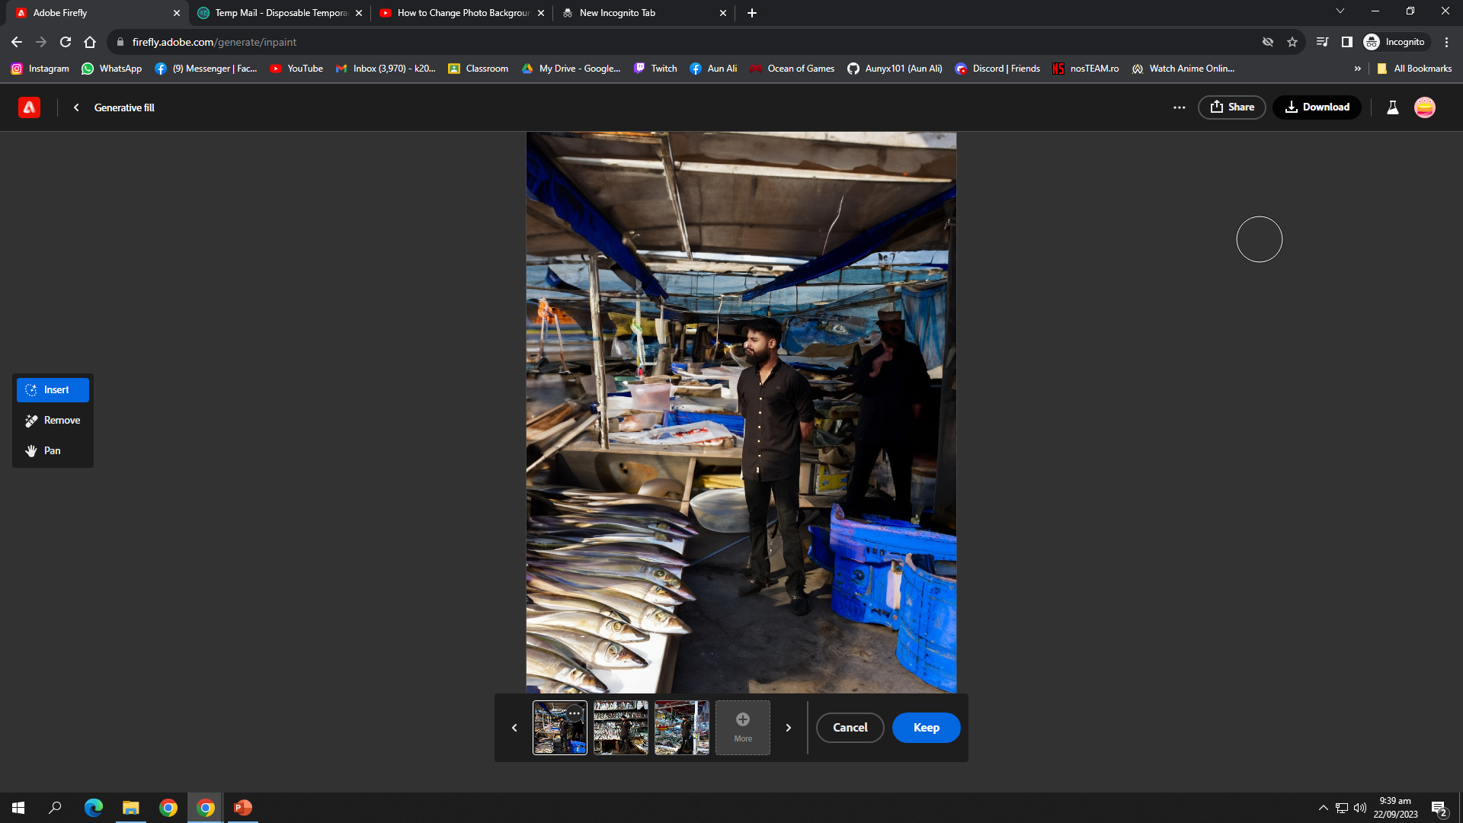
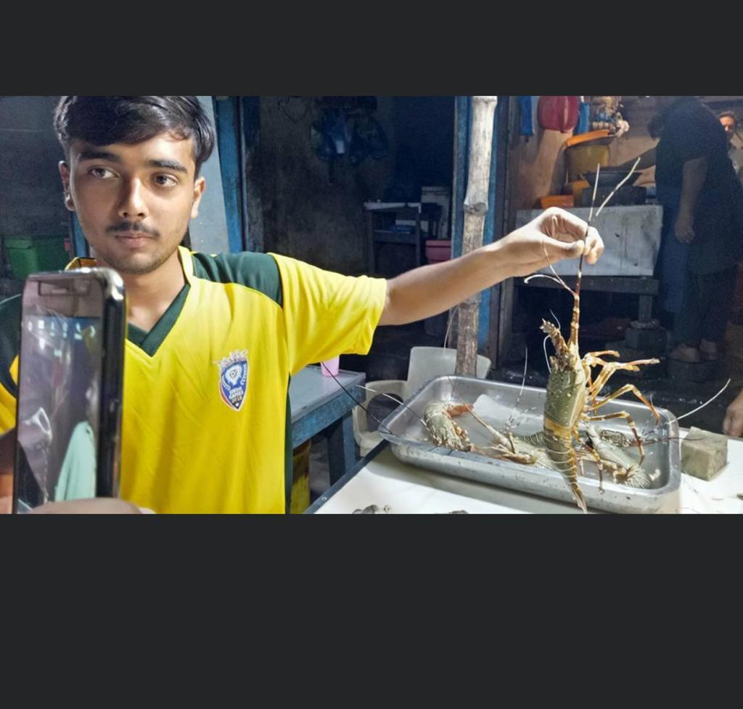
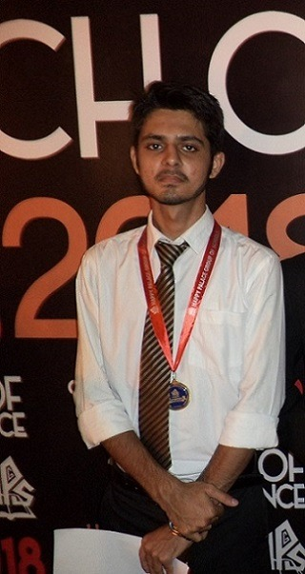
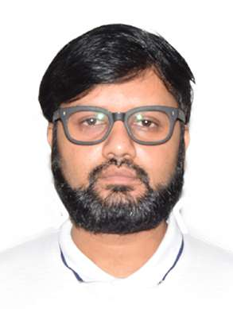
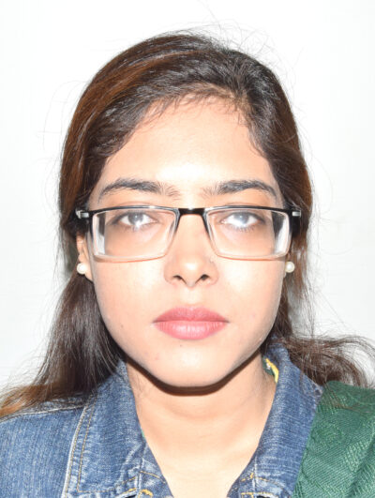
Team
Syed Aun Ali (K200286)
M. Mudabbir (K200273)
M. Fahad (K200441)
▲Collecting Dataset
Dr. Muhammad Farrukh Shahid , PhD
Ms. Sania Urooj
Assistant Professor
Co - Supervisor
Lecturer
Supervisor

Slide 3
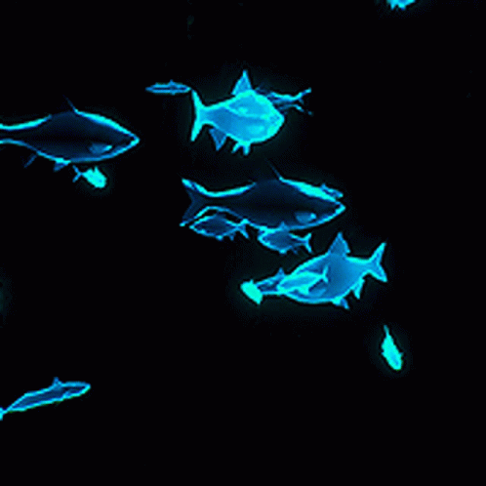
Roadmap
Introduction
Problem Statement
Scenario Comparison
Objectives
Literature Review
Data Collection
Methodology
Methodology Flow Diagram
Results
Implementation
Gantt Chart
Challenges
Contributions Towards Society
Budget
Conclusion

Slide 4
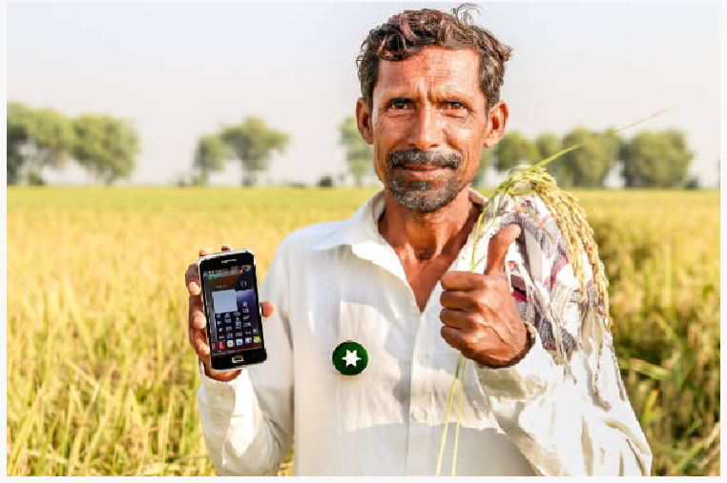
Introduction
Integrated Aquaculture-Agriculture Soil Enrichment System (IAASES): Bridging Sustainability Through Nutrient-Rich Solutions
Focuses on bridging the gap between aquaculture and agriculture using modern technology.
The primary objective is to develop an automated system for soil enrichment by integrating fish hydrolysate (and many other soil enrichment via fishery techniques) with compatible fish species.
This project addresses the growing need for sustainable soil enrichment methods, particularly in the context of agriculture in Pakistan.
Analyzing data using AI and CV models

Slide 5
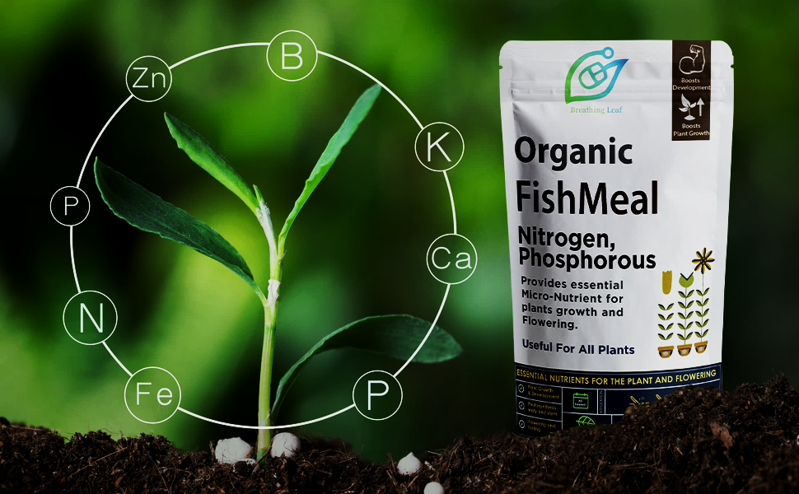
Problem Statement
In Pakistan, traditional agricultural practices and soil enrichment methods face significant challenges, including nutrient-poor soils and a lack of specifically tailored recommendations for farmers. Our project aims to develop a innovative system that bridges aquaculture and agriculture together and provide farmers with AI-driven solutions for soil enrichment.

Slide 6
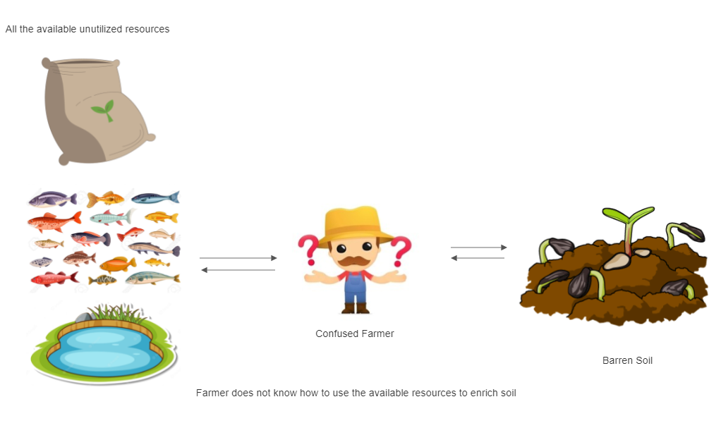
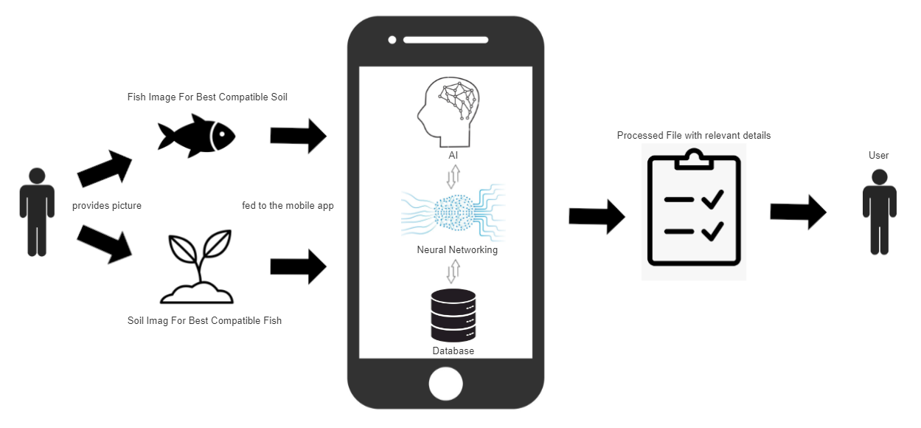
All the available unutilized resources
Current Scenario:
Confused Farmer
Barren Soil
Farmer does not know how to use the available resources to enrich soil
Fish image for best compatible soil
Proposed Scenario:
Processed file with relevant details
Provides picture
User
User
Analyzing data using AI and CV models
Soil image for best compatible fish

Slide 7
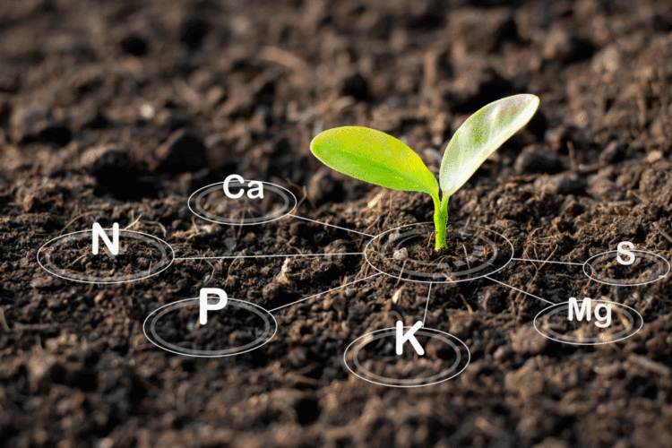
Objectives
Build a comprehensive dataset of local Fish species and soil types.
Develop a user-friendly mobile application that is capable of classifying various kinds of local soil types and fish species via smartphone’s camera.
Develop a system that recommends most compatible and protein-rich fish species for a particular soil enrichment.
Automate the fish hydrolysate system (and other techniques) for soil enrichment.
Empower local farmers by providing them with an sustainable, efficient and technology-driven solution to enhance soil fertility, hereby improving crop yields.

Slide 8
Literature Review
Published in year | Article | Authors | Field of study | Targeted Outcome
2020 | Deep Learning In Aquaculture: A Review | Ming Sun , Xiaofen Yang, Yinggang Xie | Aquaculture, Deep Learning, Neural Network | Smart Fish Health Assessment System Along With Its Classification
2019 | Fish-pak: Fish Species Dataset From Pakistan For Visual Features Based Classification | Syed Zakir Hussain Shah , Hafiz Tayyab Rauf , Muhammad Ikramullah , Malik Shahzaib Khalid , Muhammad Farooq , Mahroze Fatima , Syed Ahmad Chan Bukhari | Deep Learning And Computer Vision | Classification Of Locally Available Fishes In Pakistan
2018 | A Fish Classification On Images Using Transfer Learning And Matlab | Suryadiputra Liawatimena; Yaya Heryadi; Lukas; Agung Trisetyarso; Antoni Wibowo; Bahtiar Saleh Abbas; Erland Barlian | Image Classification, Machine Learning, Marine Animals | Fish Classification Using Matlab

Slide 9
Literature Review … (continued)
Published in year | Article | Authors | Field of study | Targeted Outcome
2018 | Aquaculture In Pakistan: Challenges And Opportunities | Muhammad Younis Laghari | Aquaculture, Challenges, Natural Resources, Opportunities, Pakistan, Production | Detailed Description On Aquaculture In Pakistan
2011 | Composting Fish Waste And Seaweed To Produce A Fertilizer For Use In Organic Agriculture Author Links Open Overlay Panel | Maria Elvira López-mosquera , Emilio Fernández-lema , Rubén Villares , Rafael Corral , Begoña Alonso , Concepción Blanco | Co-compostingdrift-seaweedfish Offalorganic Fertilizerpine Bark | Utilizing Fish Waste As Fertilizers
1998 | Composting Of Fish And The Use Of Fish Compost As A Fertilizer | P. Roinila | Fish Compost Procedure For Soil Enrichment | Detailed Description Of Fish Compost Procedure

Slide 10
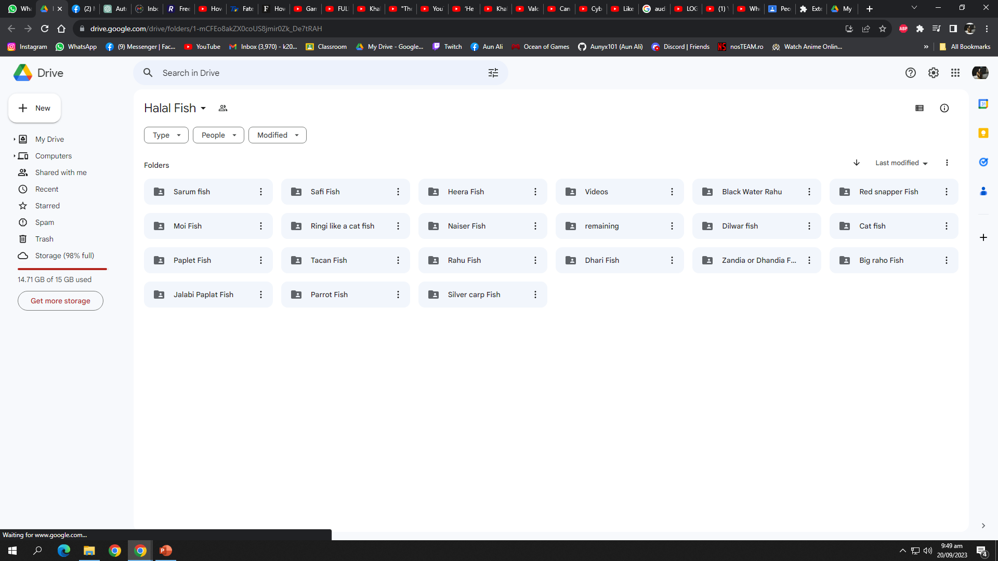
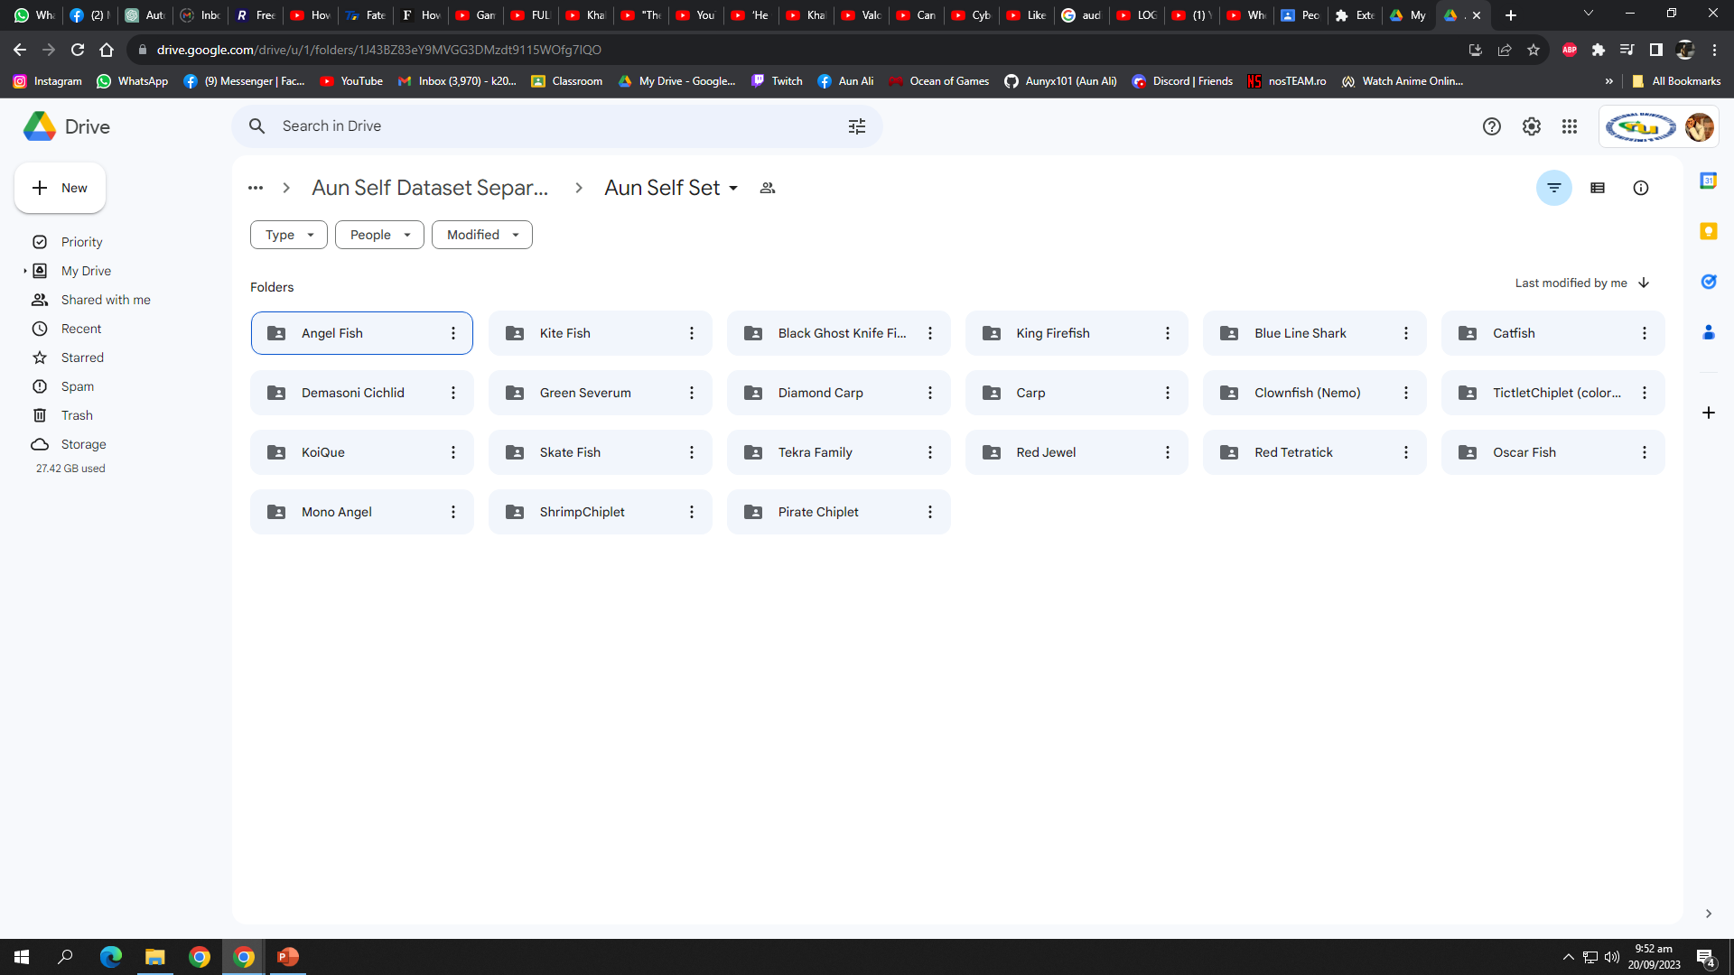
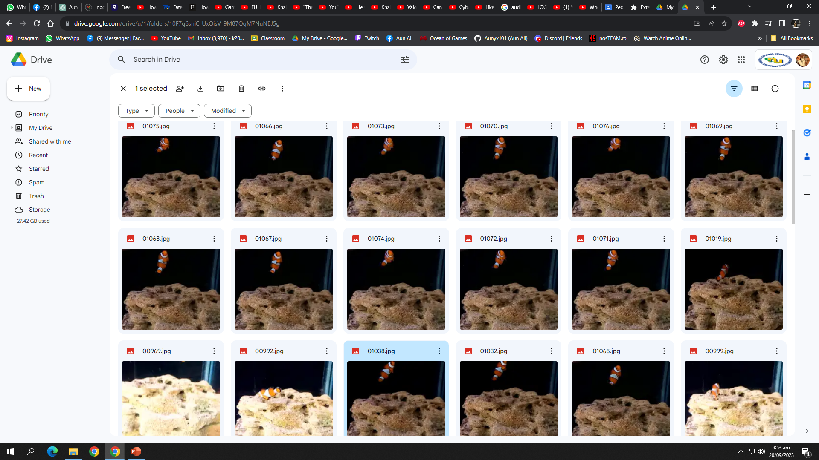
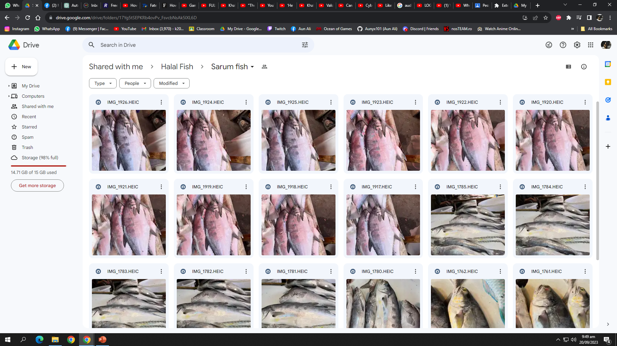
Data Collection
Rich dataset on local fish species.
Extensive efforts in data collection.
Diverse representation of fish species.
Collaborative engagement with local communities and fishermen.

Slide 11
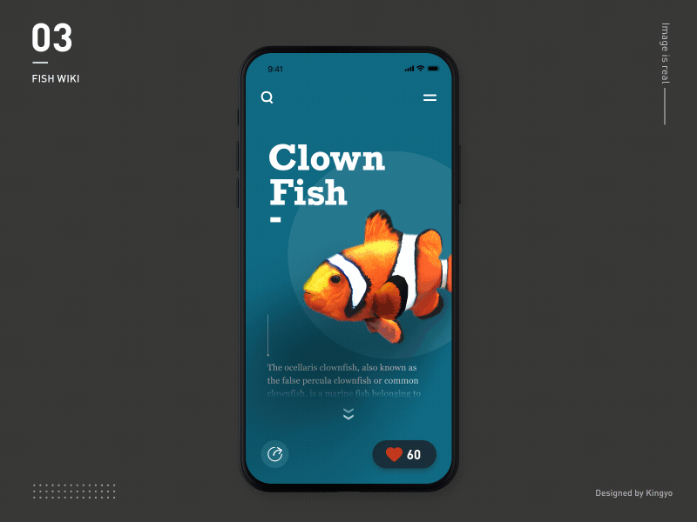
Methodology
Employ machine learning and computer vision techniques for soil and fish classification.
Collect and analyze data on soil types and nutrient requirements.
Integrate a system that is data-driven in decision-making for fish compatibility recommendations.
Explore and research on various fish-soil enrichment techniques, including Fish Emulsion, Fish Meal, Fish Composting, Fish Silage, Vermicomposting with Fish Waste, Aquaponics, and the fish hydrolysate procedure.

Slide 12
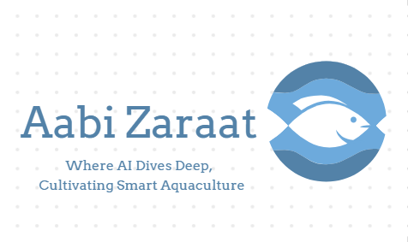
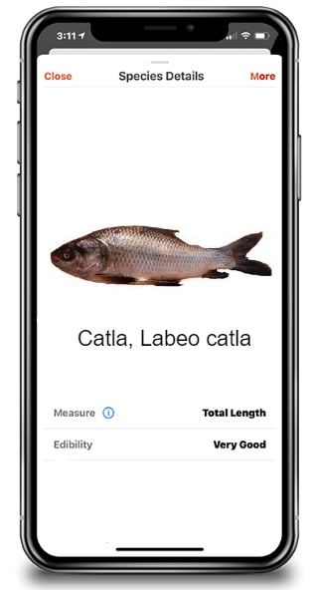
Methodology Flow Diagram
Dataset
Feature Extraction
Deep Learning Models
Trained Models
Training
Testing
Train Set
Testing Processing
Pre-Processing
Trained Models
Model Performance Evaluation
Classification
Train Set
Testing Processing
Fig 1 Block Diagram of the proposed methodology

Slide 13
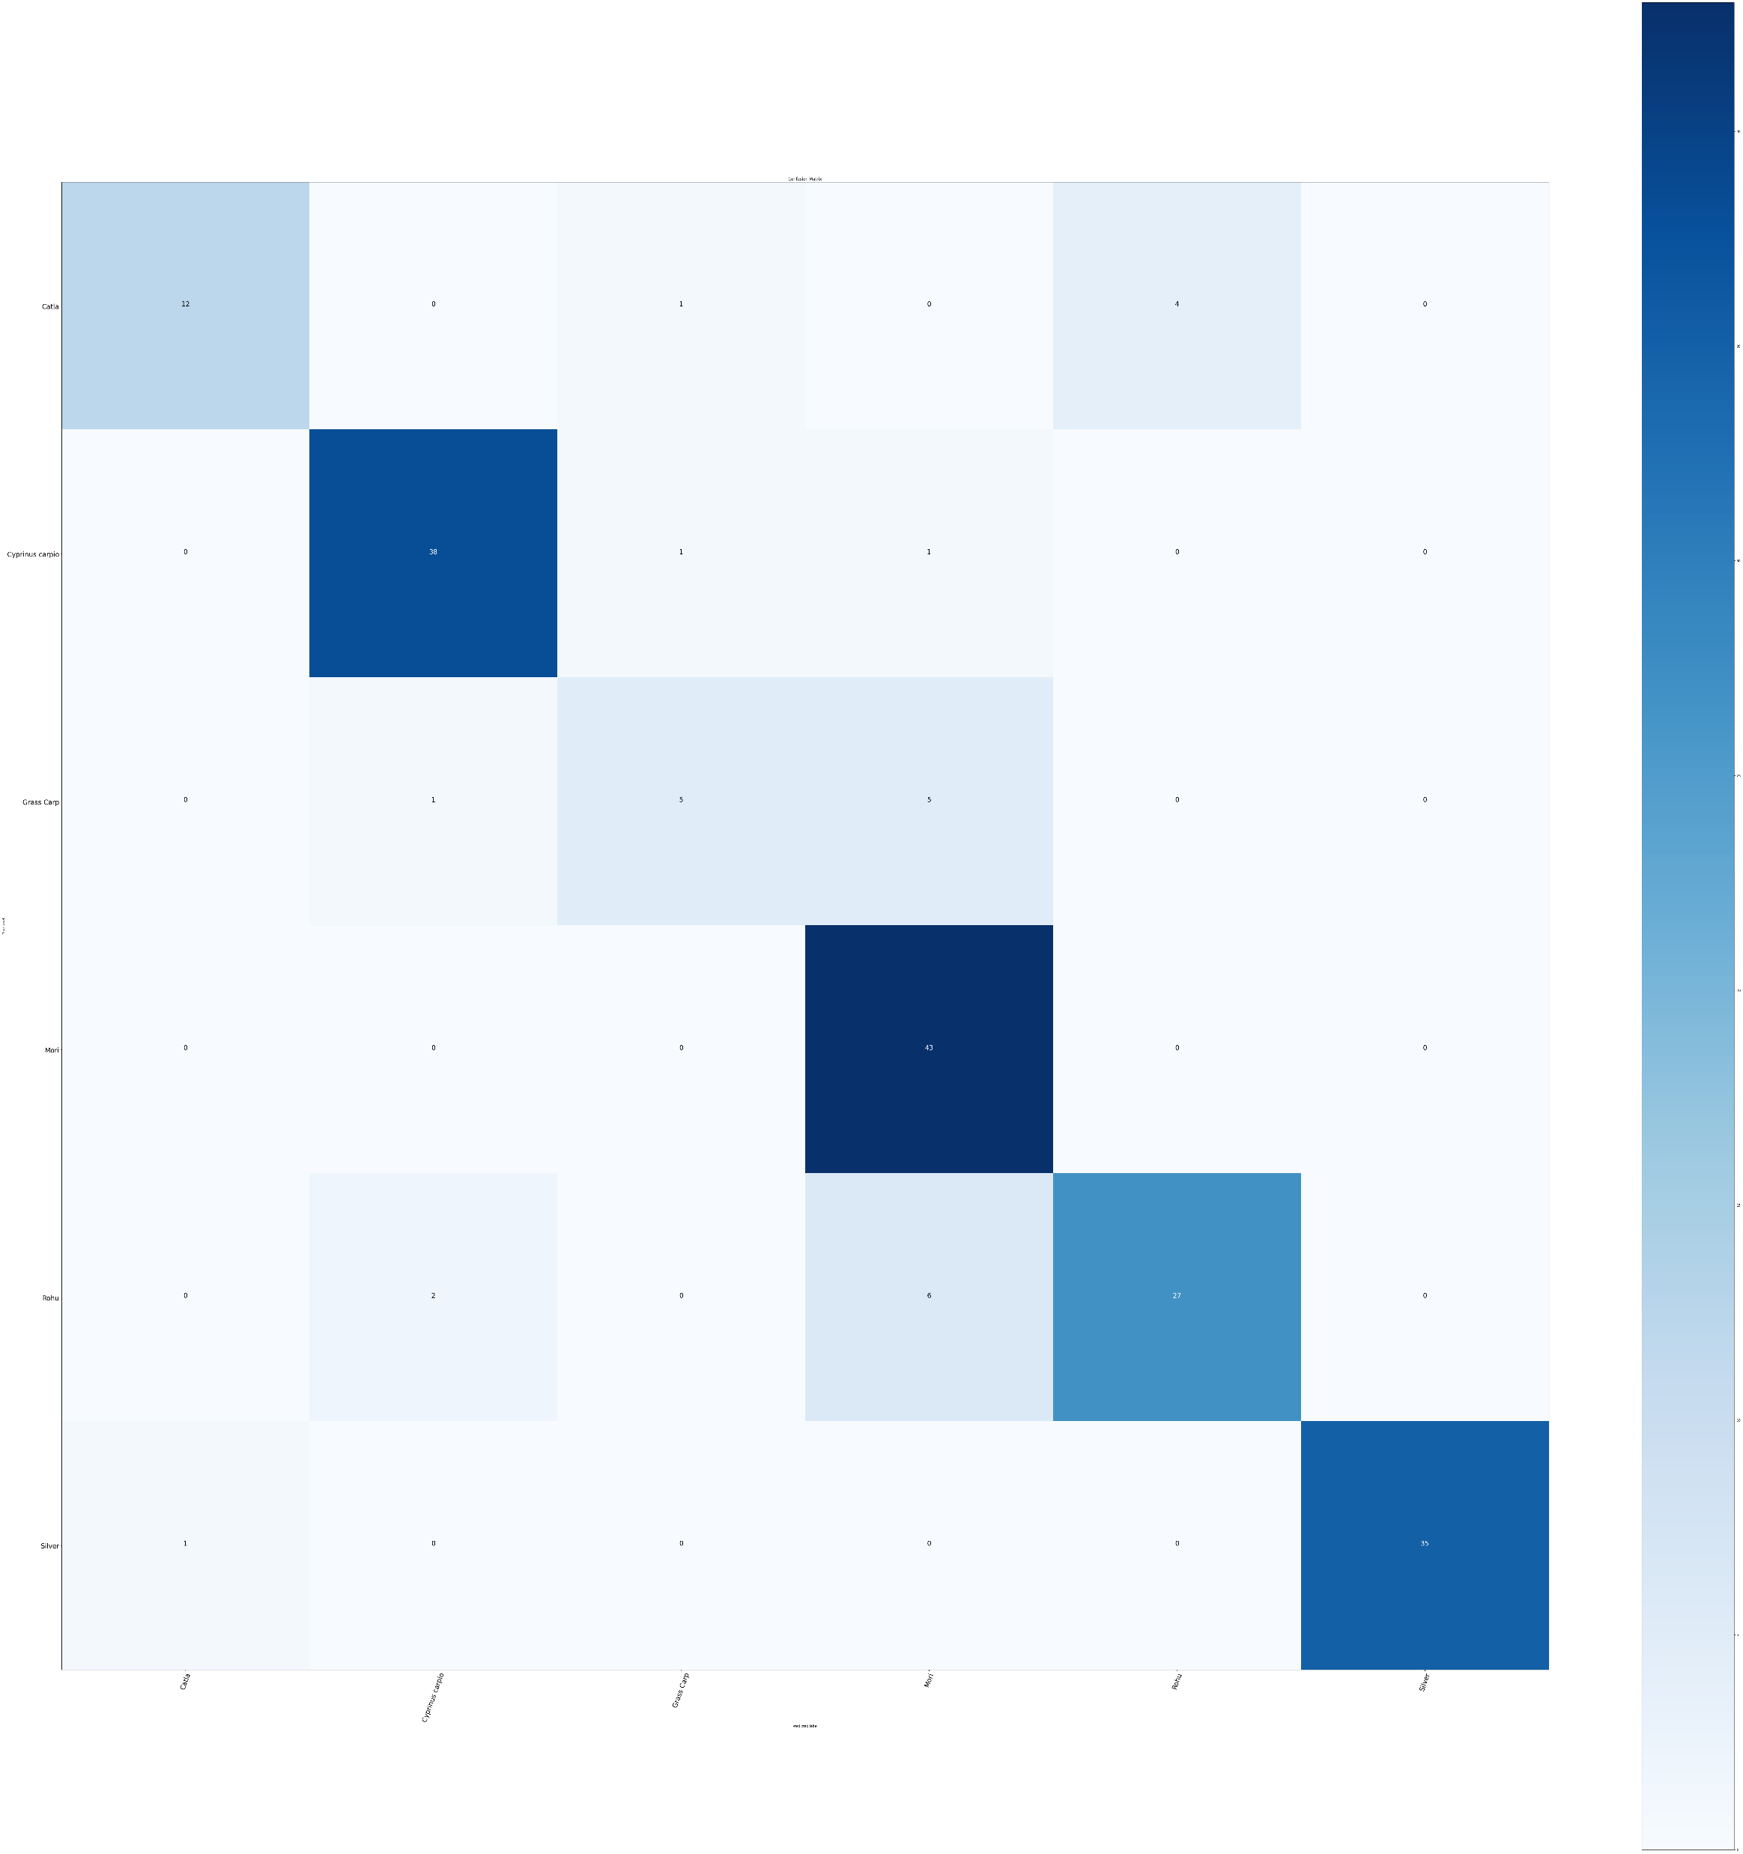
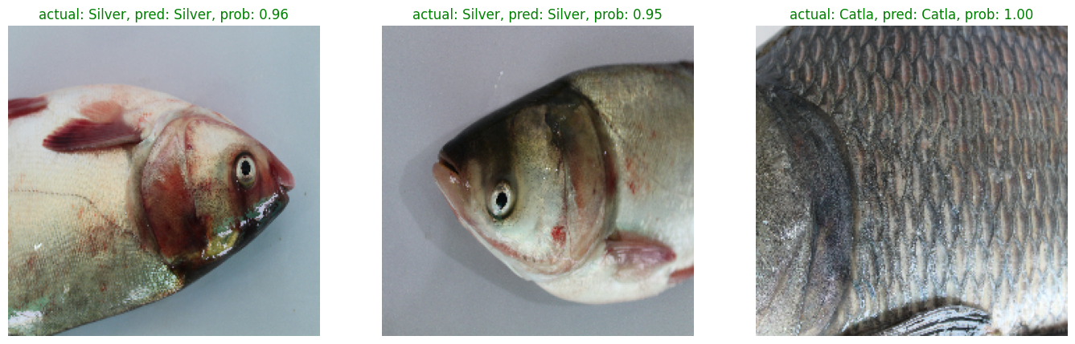
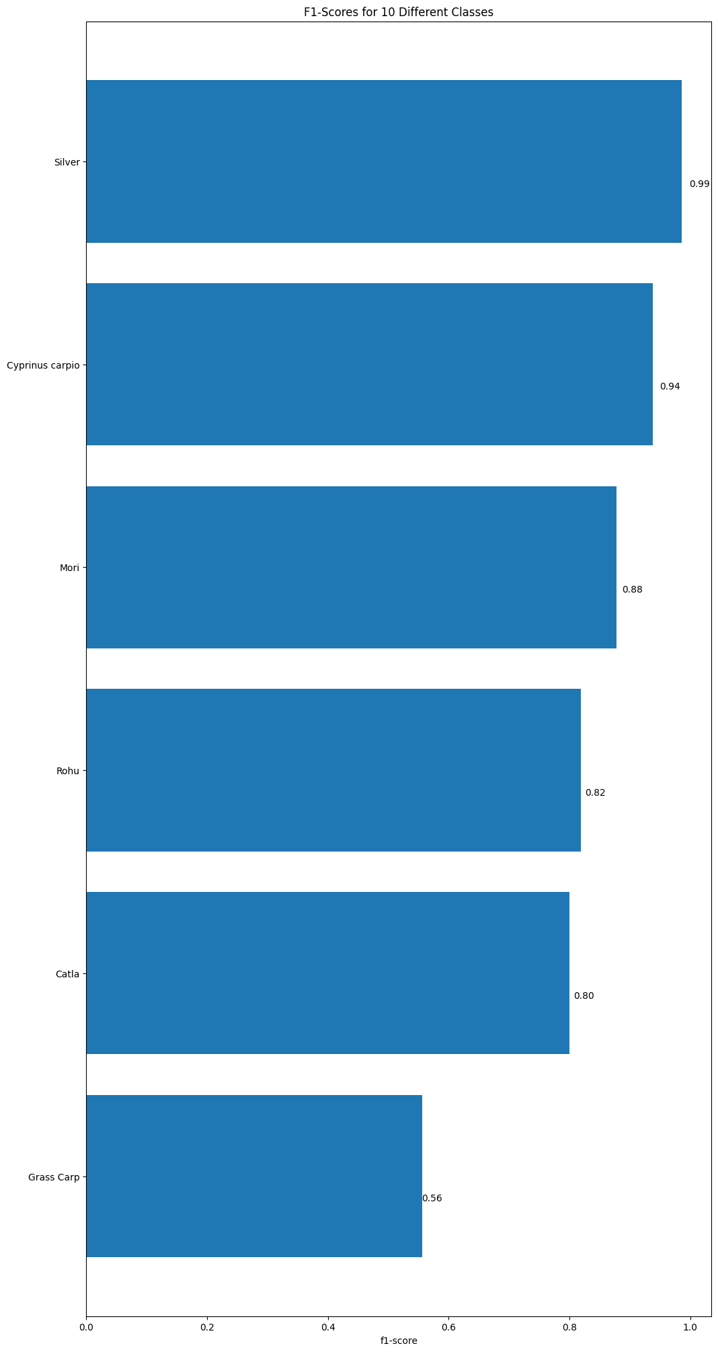
Results
The mobile application successfully classifies soil types and fishes using smartphone cameras.
Users can receive recommendations for compatible and protein-rich fish species for soil enrichment.
The application automates the fish hydrolysate system (and other techniques), facilitating nutrient and protein enrichment.
A user-friendly interface for smooth and seamless access to application’s features.
Confusion Matrix
Prediction
F1 - Score

Slide 14
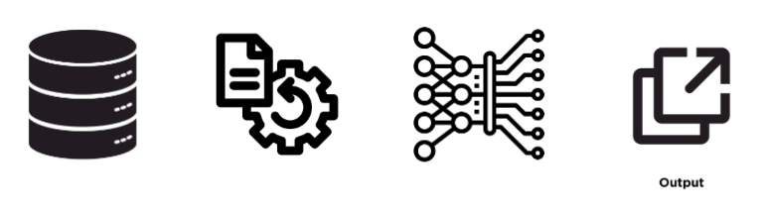
Implementation
Develop a user-friendly mobile application with a built-in soil classification system.
Incorporate a database of locally available fish species and their nutritional profiles.
Enable users to select their soil type and receive recommendations for compatible fish species.
Database
Database
Pre-Processing
DL Model
Output
▲High level abstract view

Slide 15
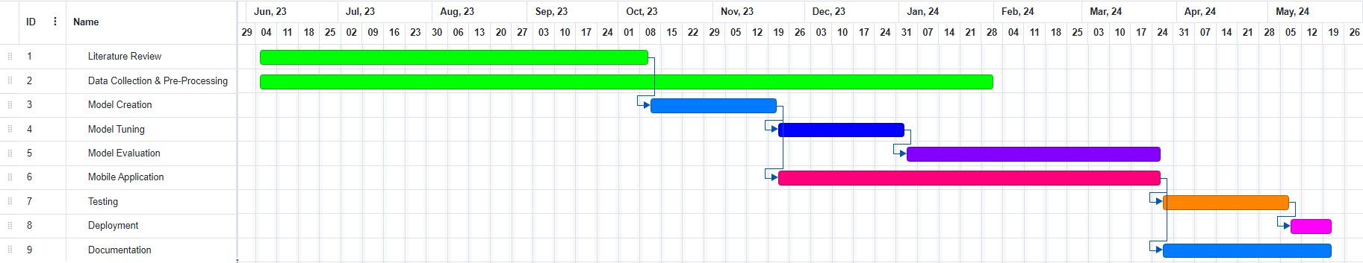
Gantt Chart

Slide 16
Challenges
A comprehensive dataset for assessing fish health, which include factors like skin diseases, eye problems, and visible indicators.
Waste of various fish species exhibiting similar levels of nutrients.
Collecting local soil dataset for accurate soil classification and enrichment recommendations is challenging.
Integration of multiple soil enrichment techniques beyond fish hydrolysate.

Slide 17
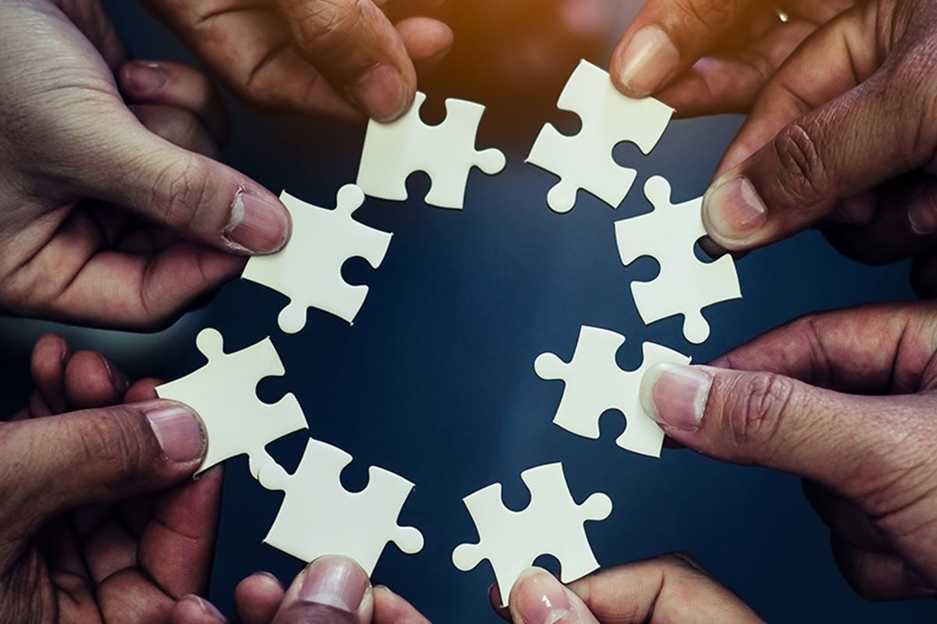
Work Contribution To Society
Increased Crop Yields: The system will have the ability to recommend the most compatible and protein-rich fish species for soil enrichment, leading to soil fertility improvement. This, in turn, enhances crop yields, ensuring food security and economic stability for local communities.
Technology Adoption: Our application encourages the adoption of advanced technologies in agriculture and aquaculture, fostering digital literacy and technology-driven innovation in rural areas.
Data Collaboration: Aabi Zaraat.ai encourages collaboration with local communities and researchers to enhance and expand datasets related to fish species, soil types, and soil health monitoring. This collaborative approach benefits the broader research and aquacultural and agricultural community.

Slide 18
Budget
Item | Category | Budget | Total
EQUIPMENTS MAJOR (>100,000) Laptop/Mac, 2 Tensor GPU and CPU for Deep Learning (M2 Mac Studio 32GB RAM 512 GB SSD) | D-equip and Material | $15,000 | $15,000
EQUIPMENTS MINOR (>10,000) Camera, Wiring, Wi-Fi Dongle | D-equip and Material | $760 | $15,760
Cloud Services (AWS/AZURE) | Computer Services and Consultants | $800 | $16,560
Dataset Drives(Fuel cost) | Computer Services and Consultants | $1000 | $17,560
Paperwork | D-equip and Material | $100 | $17,660
Internet Usage | Operating Expense | $500 | $18,160

Slide 19
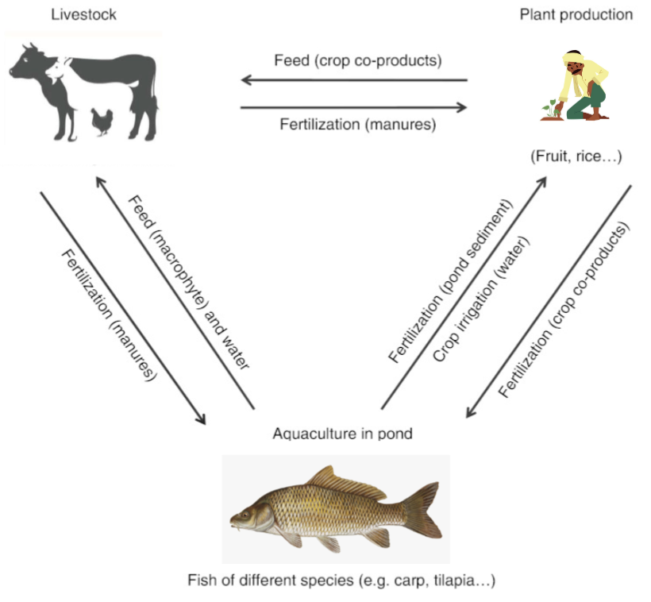
Conclusion
Potential areas for further research include real-time environmental data integration for soil health monitoring.
Expanding the fish health assessment capabilities and acquiring a suitable dataset for fish health analysis.
IAASES seeks to revolutionize agriculture in Pakistan by employing a versatile approach that integrates various techniques for soil enrichment. Our project encompasses the automation of multiple soil enrichment methods, promoting sustainability, and empowering farmers with technology-driven solutions.

Slide 20

THANK YOU! ANY QUESTIONS?

